Slide 1
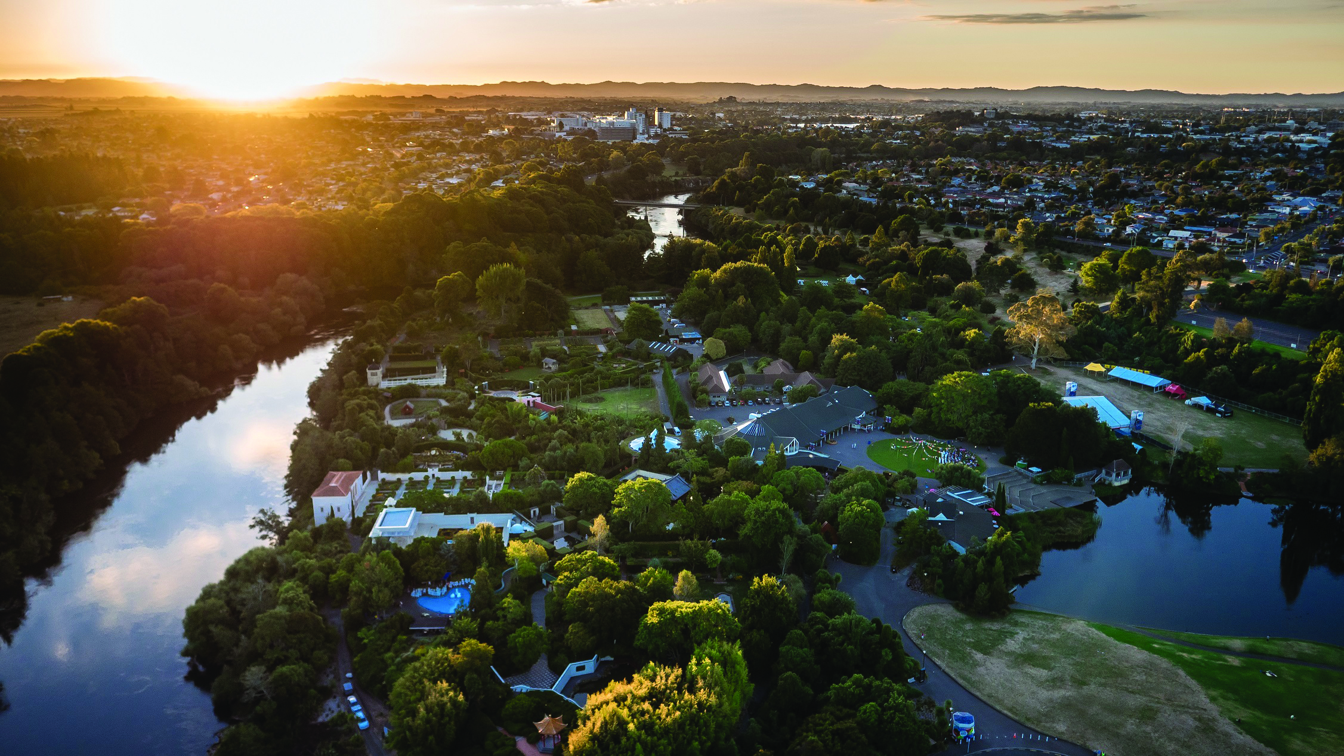
Building the Infrastructure Forward Works Pipeline
Construction Clients Group
October 2020

Slide 2
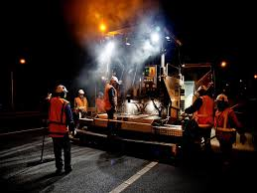
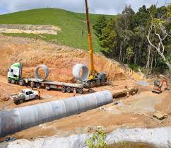
Regional and Local
Across the 12 Waikato Councils – over $5 billion of capital expenditure budgeted in 2018-28 LTP’s - in addition to maintenance and operational programmes
Including other key industry clients such as Waka Kotahi NZTA & developers - budgeted expenditure:
$275m p.a for transport
$235m p.a for three waters

Slide 3
Hamilton City Council Delivery Programme
Council has budgeted over $2 billion of capital expenditure in the 2018-28 10 Year Plan
A strong programme of existing multi-year contracts, including:
Various multi-year renewals and minor works programmes
Wastewater Treatment Plant Capacity Upgrade
Peacocke Arterial Intersection with SH3
Western Wastewater Interceptor
Peacocke Strategic Wastewater
Rotokauri Transport Hub
Wairere Drive Extension to Cobham Drive
Peacocke River Bridge & Transport Arterials
Baverstock Road Upgrade
Hillsborough Wastewater Pump Station
Central City Jetty
Te Awa Cycleway
Recently completed Ruakura Reservoir and North Ridge Drive Upgrade

Slide 4
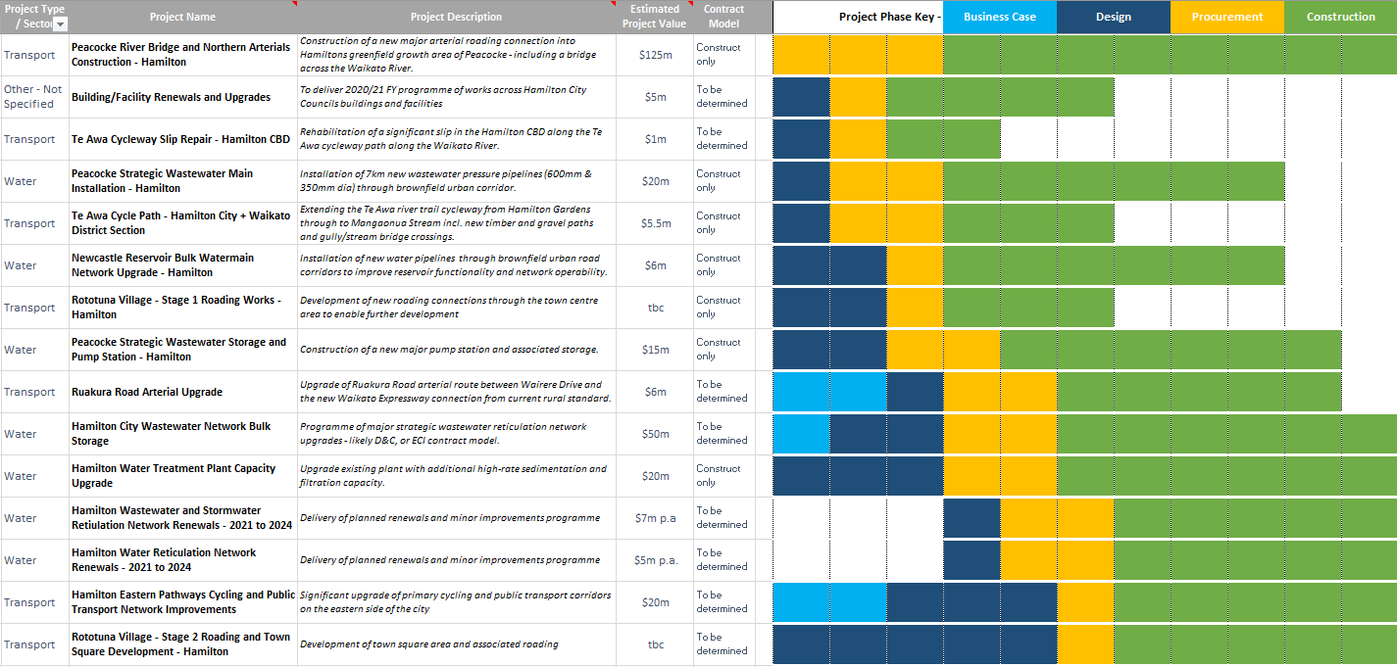
It’s not the just about the size of the pie…
Across the region Councils are committed to providing visibility of upcoming projects and contracts

Slide 5
Supporting Industry to Support Us
In order to deliver our outcomes, we are reliant on the construction industry being aligned with us.
Our aim is to support a healthy and sustainable civil construction industry, supporting business investment decisions and industry capacity and capability development through improved forward works visibility and optimising contract delivery models.
Updates will be provided locally, regionally and nationally via the Infrastructure Forward Works Pipeline.

